Slide 1
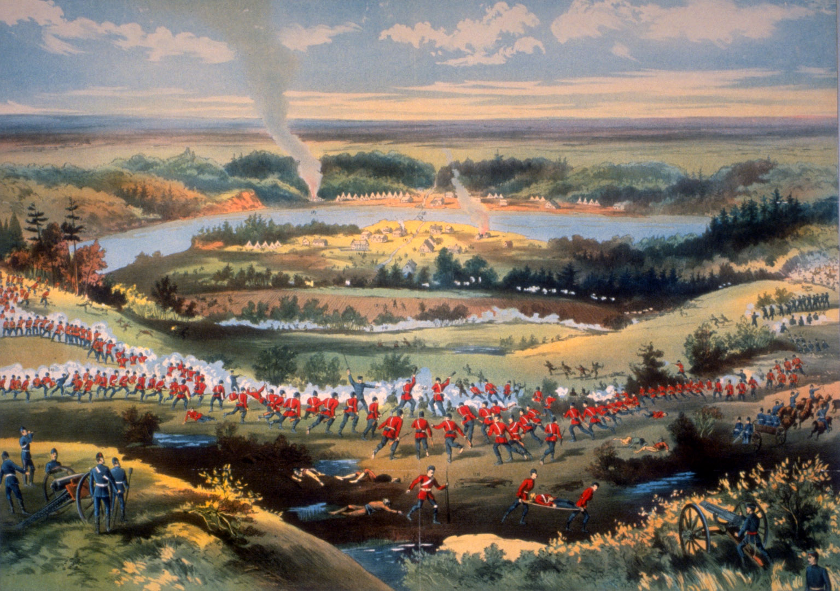
La Bataille de Batoche
La résistance Métisse et le tournant du Canada
Notes:
Image source: Microsoft 365 content library

Slide 2
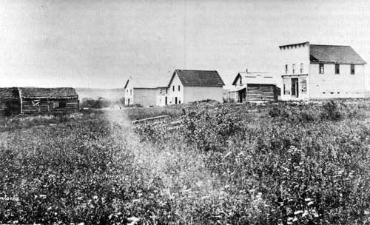
BATOCHE SETTLEMENT
UNE COMMUNAUTÉ RIVIÈRE
.
Notes:
Batoche was a thriving Métis settlement located along the South Saskatchewan River in what is now Saskatchewan. The community was organized using the traditional river-lot system, where long, narrow strips of land extended back from the river, allowing families access to water, transportation, and fertile soil. This system reflected Métis cultural values of cooperation, shared resources, and connection to the land. Batoche was home to farms, businesses, a church, and schools, making it a social, economic, and spiritual center for the Métis people of the region. The river served as a vital artery for trade and communication, linking Batoche to other communities across the Prairies. Despite its prosperity, Batoche existed in a state of uncertainty due to the Canadian government’s failure to formally recognize Métis land titles. As surveyors imposed square township grids that ignored river lots, many Métis feared displacement. These concerns were compounded by declining bison herds and increasing settlement by newcomers. Batoche thus became a focal point for political organization and resistance. Understanding Batoche as a living community, rather than merely a battlefield, is essential to appreciating why the Métis were willing to defend it. The settlement represented home, identity, and self-determination, all of which were at stake during the events of 1885. Image source: Microsoft 365 content library

Slide 3
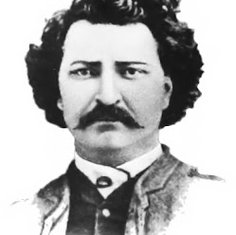

LOUIS RIEL
Chef de la résistance Métisse
This Photo by Unknown Author is licensed under CC BY-NC-ND
Notes:
Louis Riel was the political leader of the Métis resistance and one of the most complex figures in Canadian history. Educated, articulate, and deeply religious, Riel believed he had a divine mission to defend the rights of his people. He had previously led the Red River Resistance of 1869–1870, which resulted in the creation of the province of Manitoba. After that conflict, Riel was forced into exile due to political opposition and threats to his life. When Métis leaders in Saskatchewan asked him to return in 1884, Riel initially hoped to resolve grievances through peaceful negotiation. He organized a provisional government and drafted petitions outlining Métis demands. As the government failed to respond, Riel’s rhetoric became more intense, blending political arguments with religious language. During the Battle of Batoche, Riel remained primarily a political and spiritual leader rather than a battlefield commander. After the defeat, he surrendered, believing in the rule of law. His subsequent trial and execution made him a symbol of injustice to many and a traitor to others. Today, Riel is widely recognized as a Father of Confederation and a champion of Métis rights. Image source: Microsoft 365 content library

Slide 4
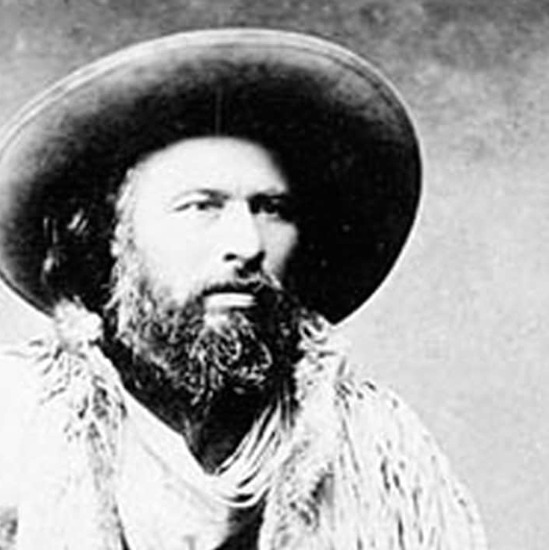

GABRIEL DUMONT
CHEF MILITAIRE À BATOCHE
Notes:
Gabriel Dumont served as the military leader of the Métis forces during the Battle of Batoche and was renowned for his tactical skill and deep knowledge of the land. A celebrated buffalo hunter and trader, Dumont understood prairie warfare and guerrilla tactics better than most professional soldiers of his time. Unlike Louis Riel, Dumont was skeptical of prolonged political negotiation and believed that the Métis needed to prepare for armed defense. He organized fighters, selected defensive positions, and oversaw the construction of rifle pits that used the natural terrain for cover. Dumont favored mobility, marksmanship, and surprise attacks, which initially frustrated Canadian troops. However, despite his leadership, the Métis forces were limited by a lack of ammunition, manpower, and heavy weaponry. Dumont often disagreed with Riel’s strategic decisions but remained loyal to the cause. After the fall of Batoche, Dumont fled to the United States, where he later joined Buffalo Bill’s Wild West Show. His role in 1885 highlights the Métis tradition of resilience and adaptability in the face of overwhelming odds. Image source: Microsoft 365 content library

Slide 5
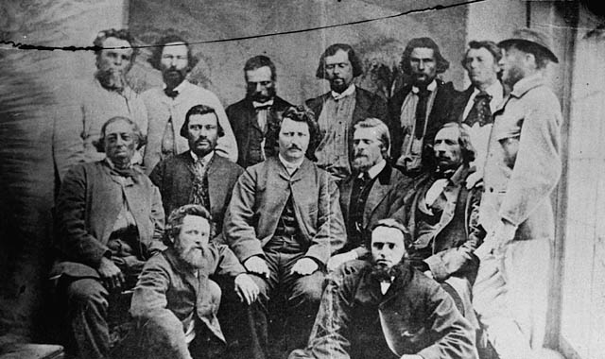
Gouvernement provisoire de la nation métisse
Notes:
Gabriel Dumont served as the military leader of the Métis forces during the Battle of Batoche and was renowned for his tactical skill and deep knowledge of the land. A celebrated buffalo hunter and trader, Dumont understood prairie warfare and guerrilla tactics better than most professional soldiers of his time. Unlike Louis Riel, Dumont was skeptical of prolonged political negotiation and believed that the Métis needed to prepare for armed defense. He organized fighters, selected defensive positions, and oversaw the construction of rifle pits that used the natural terrain for cover. Dumont favored mobility, marksmanship, and surprise attacks, which initially frustrated Canadian troops. However, despite his leadership, the Métis forces were limited by a lack of ammunition, manpower, and heavy weaponry. Dumont often disagreed with Riel’s strategic decisions but remained loyal to the cause. After the fall of Batoche, Dumont fled to the United States, where he later joined Buffalo Bill’s Wild West Show. His role in 1885 highlights the Métis tradition of resilience and adaptability in the face of overwhelming odds. Image source: Microsoft 365 content library

Slide 6
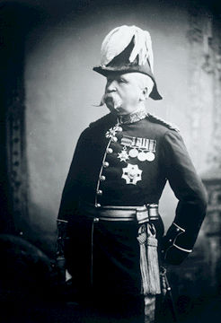

Major-général
Frederick Middleton
Commandant des forces
de campagne du Nord-Ouest
Notes:
One of the most distinctive features of the Battle of Batoche was the use of rifle pits by Métis fighters. These shallow trenches were carefully dug into the landscape, often concealed by grass and natural contours. Rifle pits allowed Métis marksmen to fire while remaining protected from enemy bullets and artillery. This defensive strategy reflected Gabriel Dumont’s experience as a hunter and warrior. The pits slowed the militia’s advance and inflicted casualties, frustrating soldiers unaccustomed to this style of combat. However, rifle pits were only effective as long as ammunition lasted. As the battle wore on, shortages became critical. Despite their ingenuity, the Métis defenses could not compensate for the overwhelming resources of the Canadian forces. The rifle pits remain a powerful symbol of Métis resilience and tactical skill. Image source: Microsoft 365 content library

Slide 7
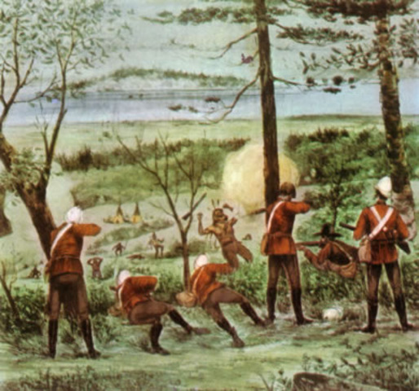
La police montée du Nord-Ouest se mobilise
Notes:
When news of resistance reached Ottawa, the Canadian government acted swiftly to assert control. Thousands of militia troops were mobilized from Ontario, Quebec, and other regions, demonstrating the federal government’s determination to maintain authority in the West. The recently completed Canadian Pacific Railway played a crucial role, allowing troops, supplies, and artillery to be transported rapidly across vast distances. This logistical advantage gave government forces a decisive edge. Many of the soldiers were young volunteers with limited combat experience, but they were well-armed and supported by professional officers. The government framed the conflict as a rebellion that threatened national stability, justifying a strong military response. For the Métis, the arrival of such a large force confirmed fears that peaceful resolution was no longer possible. The mobilization of the militia marked a turning point, transforming a regional political dispute into a full-scale military confrontation. Image source: Microsoft 365 content library

Slide 8
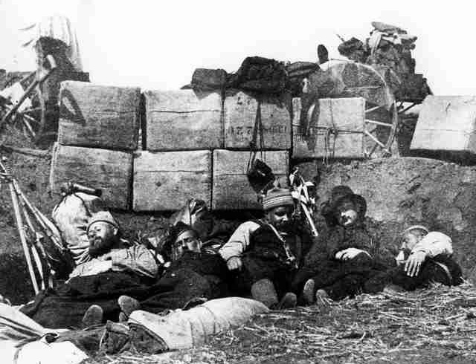
Des soldats dorment derrière les remparts fortifiés de Batoche
Notes:
When news of resistance reached Ottawa, the Canadian government acted swiftly to assert control. Thousands of militia troops were mobilized from Ontario, Quebec, and other regions, demonstrating the federal government’s determination to maintain authority in the West. The recently completed Canadian Pacific Railway played a crucial role, allowing troops, supplies, and artillery to be transported rapidly across vast distances. This logistical advantage gave government forces a decisive edge. Many of the soldiers were young volunteers with limited combat experience, but they were well-armed and supported by professional officers. The government framed the conflict as a rebellion that threatened national stability, justifying a strong military response. For the Métis, the arrival of such a large force confirmed fears that peaceful resolution was no longer possible. The mobilization of the militia marked a turning point, transforming a regional political dispute into a full-scale military confrontation. Image source: Microsoft 365 content library

Slide 9
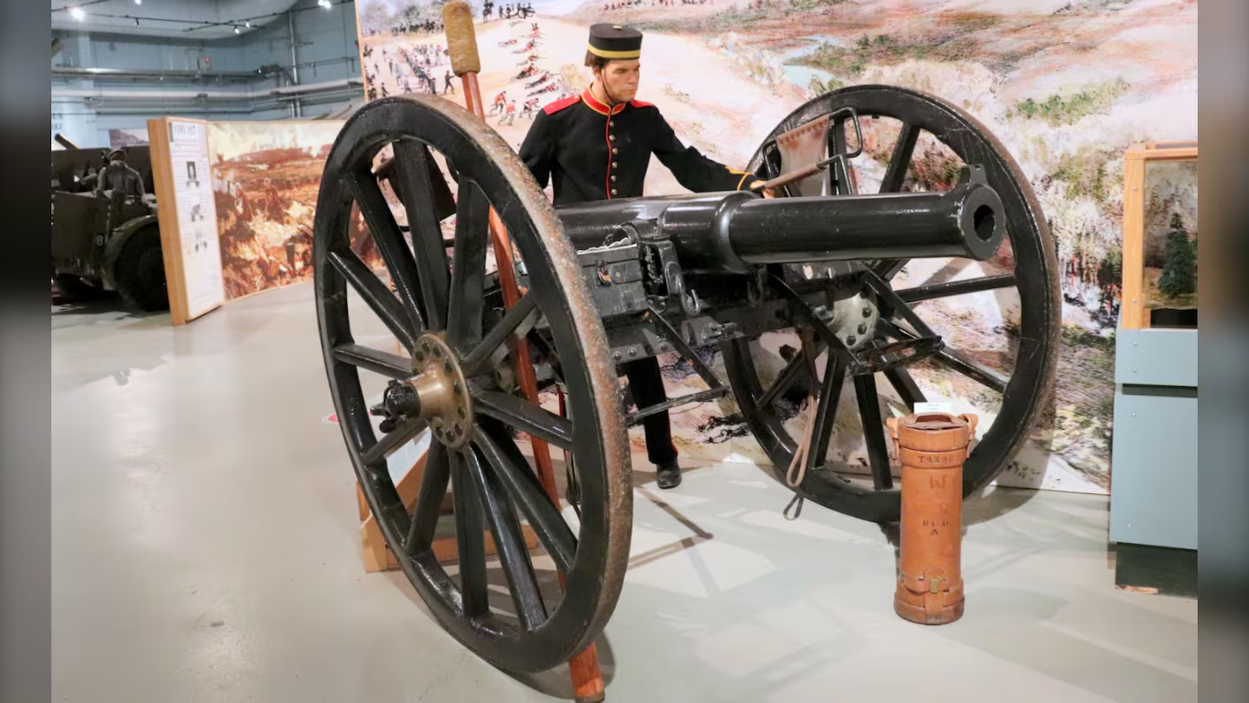
Le canon rayé à chargement par la bouche (RML) de neuf livres
Notes:
The church at Batoche stood at the center of the community and became a focal point during the battle. Fighting around the church grounds symbolized the deep personal and spiritual stakes of the conflict. For many Métis families, the church was a place of worship, gathering, and refuge. Its proximity to combat blurred the line between civilian life and warfare. The presence of the church on the battlefield highlights how the conflict disrupted every aspect of daily life. Even as bullets flew, faith and community remained sources of strength. The church’s survival and preservation today serve as a powerful reminder of the human dimension of the Battle of Batoche. Image source: Microsoft 365 content library

Slide 10
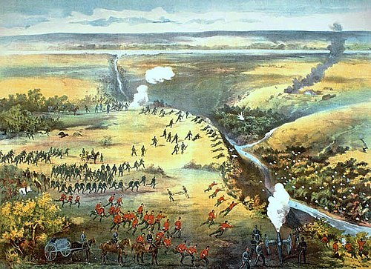
Bataille de
Fish Creek
Notes:
The Battle of Batoche officially began on May 9, 1885, when Canadian forces engaged Métis defenders outside the settlement. Initial fighting involved long-range exchanges of gunfire, with Métis marksmen using rifle pits to their advantage. The opening day demonstrated that the Métis were capable and determined fighters, able to delay and challenge a much larger force. For the militia, the resistance was stronger than expected, leading to caution and delays. Civilians sheltered in homes and churches as fighting erupted around them. The events of May 9 set the tone for the days that followed, revealing both the strengths and limitations of Métis defenses. It also marked the moment when political resistance irrevocably became a military struggle. Image source: Microsoft 365 content library

Slide 11
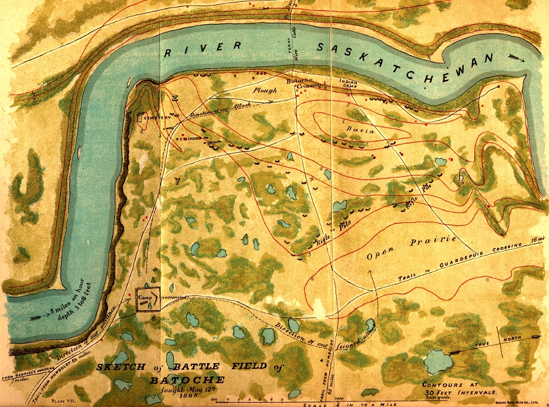
Bataille de Batoche
Notes:
A critical challenge for the Métis during the battle was the severe shortage of ammunition. With limited access to supplies, fighters were forced to conserve bullets and retrieve spent ammunition from the battlefield. This shortage restricted their ability to maintain defensive fire and reduced the effectiveness of rifle pits. In contrast, Canadian troops had ample supplies and artillery support. The ammunition crisis ultimately weakened Métis resistance and contributed directly to their defeat. It illustrates how logistical disadvantages can determine the outcome of conflicts, regardless of courage or skill. Image source: Microsoft 365 content library

Slide 12
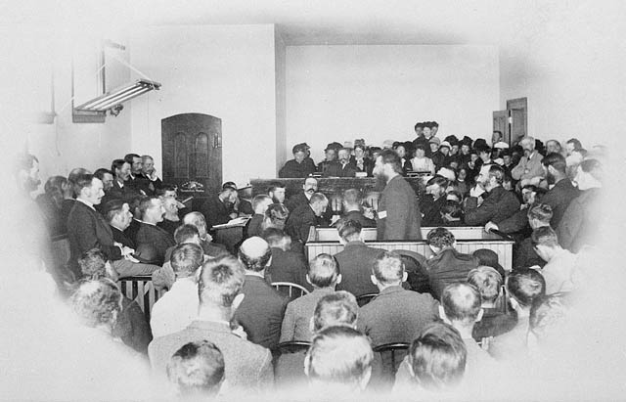
Le procès de
Louis Riel
Notes:
Louis Riel’s trial took place in Regina and was highly controversial. Charged with treason, Riel faced a legal system that many argued was biased and politically motivated. His defense focused on his mental state and his belief that he was acting in the best interests of his people. Despite public debate and calls for clemency, Riel was convicted. The trial exposed deep divisions in Canadian society, particularly between English and French Canadians, and raised lasting questions about justice and minority rights. Image source: Microsoft 365 content library

Slide 13
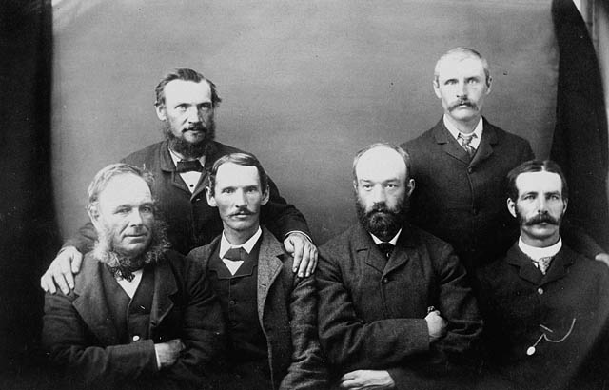
Jury du procès
de Riel
Notes:
Louis Riel was executed on November 16, 1885. His death shocked the nation and intensified political and cultural divisions. For many Métis and Indigenous peoples, Riel became a martyr and symbol of resistance. For others, he remained a controversial figure. The execution had lasting consequences, influencing Canadian politics and shaping the national conversation around rights, identity, and reconciliation. Riel’s legacy continues to evolve as perspectives change. Image source: Microsoft 365 content library

Slide 14
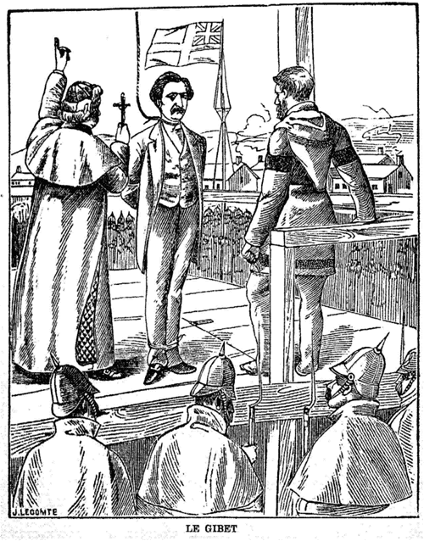
L'exécution
de Louis Riel
Notes:
Louis Riel was executed on November 16, 1885. His death shocked the nation and intensified political and cultural divisions. For many Métis and Indigenous peoples, Riel became a martyr and symbol of resistance. For others, he remained a controversial figure. The execution had lasting consequences, influencing Canadian politics and shaping the national conversation around rights, identity, and reconciliation. Riel’s legacy continues to evolve as perspectives change. Image source: Microsoft 365 content library

Slide 15
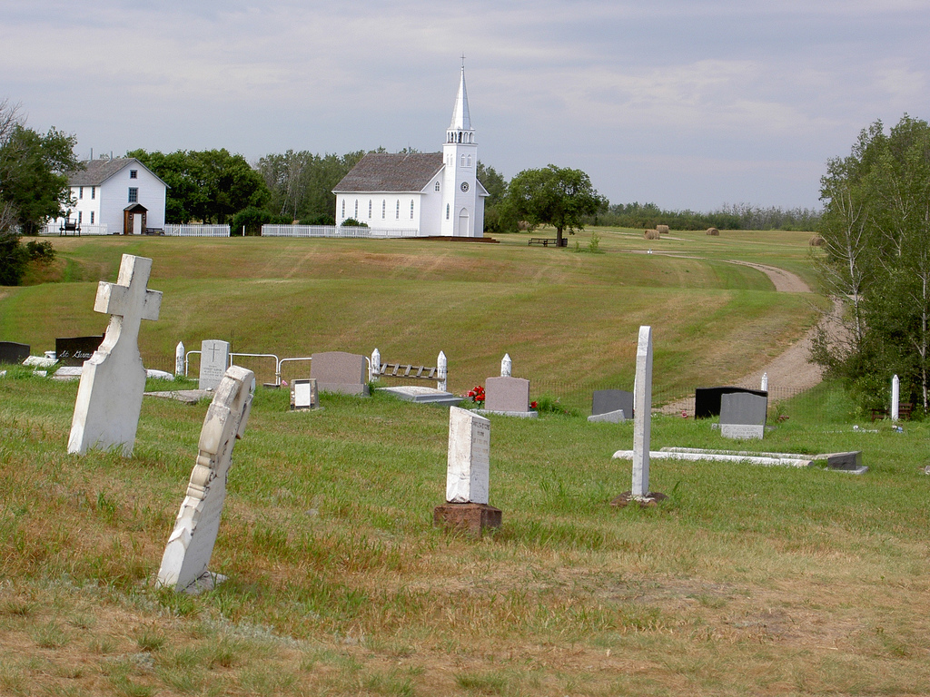
Site historique national de Batoche - Un symbole de la résistance métisse
Notes:
The aftermath of the Battle of Batoche was marked by repression and hardship for the Métis. Political organizations were dismantled, leaders were imprisoned or exiled, and communities faced discrimination and poverty. The defeat reinforced federal control over the West and accelerated settlement and development. However, Métis culture and identity endured despite these challenges. The aftermath illustrates how military defeat can have long-lasting social and cultural consequences. Image source: Microsoft 365 content library

